Slide 1

CS7302 Big Data Analytics
Module 2
Course Instructor
Dr. S. Pitchumani Angayarkanni
Professor

Slide 2
Content Outline
Large Scale Data Processing with PySpark
Spark - RDDs, DataFrames, Spark SQL
PySpark + NumPy + SciPy, Code Optimization, Cluster Configurations
Linear Algebra Computation in Large Scale.
Distributed File Storage Systems

Slide 3
Spark - RDDs, DataFrames

Slide 4
A DataFrame is a distributed collection of data organized into named columns.
A Dataframe in Spark is a data structure that includes data schema similar to a table in a relational database or a Dataframe in R or Python libraries like Pandas.
A Dataframe in PySpark differs from a Pandas Dataframe.
A Spark Dataframe
it is a distributed data structure while in Pandas it is a local data structure on a single machine and not scalable to use for large datasets.
In your implementation you should not use Pandas Dataframe and Spark Dataframe in the same code.
Spark SQL is Spark’s module for working with structured data.
You can create and query structured data inside
Spark programs, using either SQL or DataFrame API.
A sparkcontext or sparksession is the main entry point for working with DataFrame and SQL functionality. Example of sparkSession and sqlContext for a stand-alone installation of Spark on local machine (”local[*]” is the name of the standalone local machine).

Slide 5
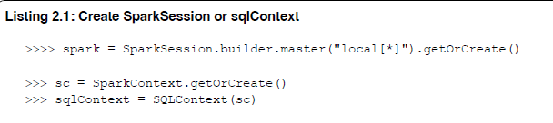

Slide 6
DataFrames: DataFrames are a more structured and optimized way of working with data in Spark, built on top of RDDs.
They provide a higher-level abstraction that resembles a table in a relational database, with named columns and well-defined data types.
DataFrames support a wide range of operations, including projection, filtering, joining, aggregation, and more.
They are designed to work with both structured and semi-structured data formats, such as JSON, CSV, and Parquet.
DataFrames can be created from various data sources, including RDDs, external data sources (e.g., files, databases), or by converting existing RDDs to DataFrames.

Slide 7
Create a Dataframe
A Spark dataFrame can be constructed from different sources such as:
Structured data files, (CSV, JSON, ... )
External databases (MySql, PostgreSQL, S3, JDBS, ... )
Existing RDDs in memory
createDataFrame(createDataFrame(data, schema=None, samplingRatio=None) on sqlContext
creates a Spark dataframe from a python list.
On Spark dataframes similar to Spark RDDs we have collect() operation which can pull the distributed data (dataframe or RDD) to the driver (Driver is the process that submits the Spark scripts to the master node).

Slide 8
SparkSession:
Introduced in Spark 2.0, SparkSession is the entry point for working with structured data (like DataFrames and Datasets) in Spark.
It provides a unified interface for various Spark functionalities, including SQL queries, streaming data, and working with external data sources.
You can use SparkSession to create DataFrames, register DataFrames as tables, execute SQL queries, and read data from various sources.
In most cases, you'll use SparkSession when working with DataFrames in PySpark.

Slide 9
SparkContext:
SparkContext is the entry point for low-level Spark functionalities, such as working with RDDs (Resilient Distributed Datasets).
It's used to create RDDs, broadcast variables, and accumulate values across the cluster.
In earlier versions of Spark, SparkContext was also used to create SQLContext for working with DataFrames. However, with the introduction of SparkSession, the use of SparkContext for DataFrames has become less common.
SQLContext:
SQLContext is a context for working with structured data in Spark. It was used in earlier versions of Spark to create DataFrames, register them as tables, and execute SQL queries.
With the introduction of SparkSession in Spark 2.0, SQLContext has become less relevant, as SparkSession provides all the functionalities of SQLContext and more.

Slide 10
Read JSON file
spark.read.option().json()
what are the arguments of option
key: The name of the option you want to set.
value: The value to assign to the option.

Slide 11
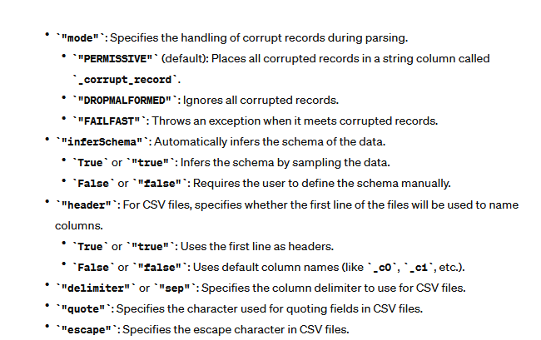

Slide 12
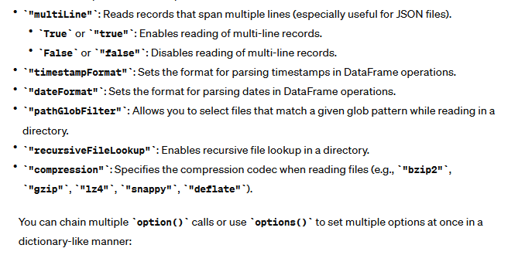

Slide 13
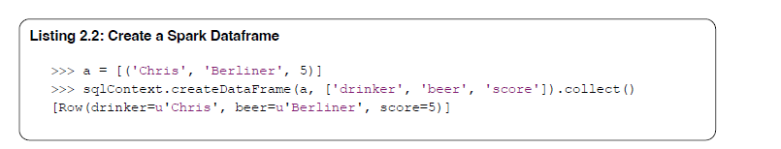
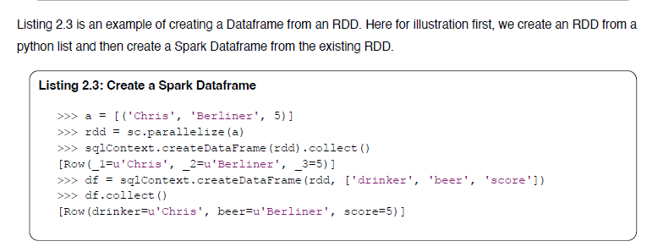

Slide 14
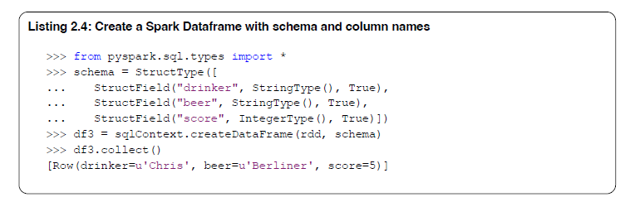
Spark system can automatically detect the data schema and create a Dataframe from an RDD or a list. Spark gives also automated names to the Dataframe columns besides the automated schema.
Listing 2.4 is an example of how you can add your schema specification and columns names to create a Spark Dataframe.

Slide 15
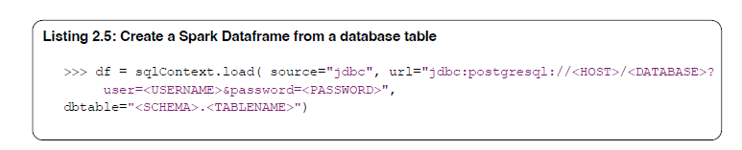
Listing 2.5 is an example of importing data from a database and creating Spark Dataframe. In this example, we create a Dataframe by proving a JDBC (Java Database Connectivity) driver url.

Slide 16
Create a Dataframe from a JSON File.
You can use the operation jsonFile(PATH) to create a Dataframe from a JSON file.
Columns of the Dataframe will have the key names of the Json object and Spark detects automatically the data types.
You can change the data types after creating the Dataframe if needed.
Listing 2.6 shows an example of this operation and creates a Dataframe from a file path (In this example Path is a local file but it can be any Path including distributed file.)

Slide 17
Characteristics
Immutable in nature: We can create DataFrame / RDD once but can’t change it. And we can transform a DataFrame / RDD after applying transformations.
Lazy Evaluations: Which means that a task is not executed until an action is performed.
Distributed: RDD and DataFrame both are distributed in nature.

Slide 18
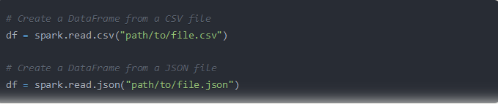
Creating a DataFrame from Spark Data Sources
You can create a DataFrame directly from various data sources supported by Spark, such as CSV, JSON, Parquet, and others, using the spark.read method.

Slide 19
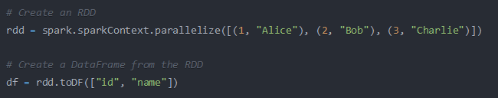
Creating a DataFrame from RDD
You can create a DataFrame from an existing RDD by applying a schema using the toDF method.

Slide 20
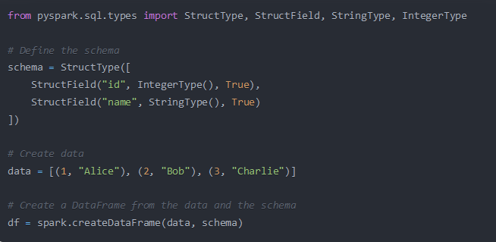
Creating a DataFrame with a Schema using StructType and StructField
You can define a schema explicitly using StructType and StructField from the pyspark.sql.types module, and then create a DataFrame from data.

Slide 21
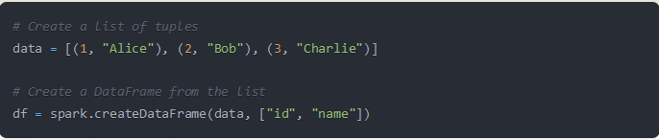
Creating a DataFrame using SparkSession and createDataFrame
:You can create a DataFrame directly from a list or RDD using the createDataFrame method of the SparkSession

Slide 22
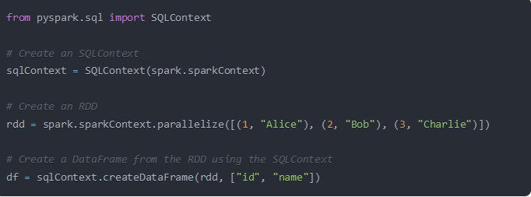

Creating a DataFrame from SQL Context (legacy)
In earlier versions of Spark, you could create a DataFrame using the SQLContext (deprecated in Spark 2.0 and replaced by SparkSession

Slide 23
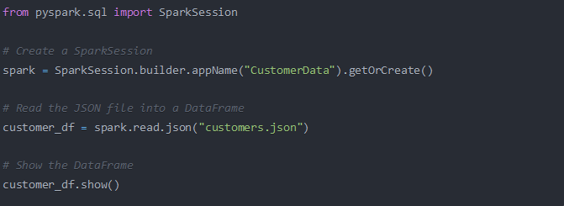
Create Dataframe from JSON File

Slide 24
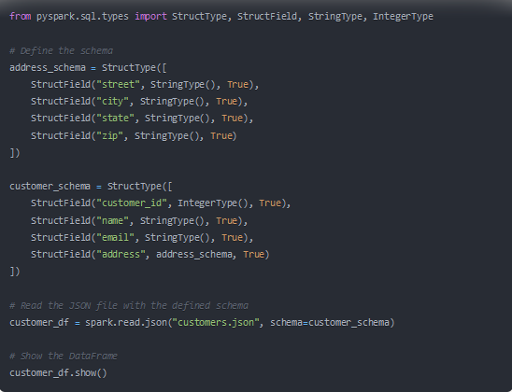
With Schema

Slide 25
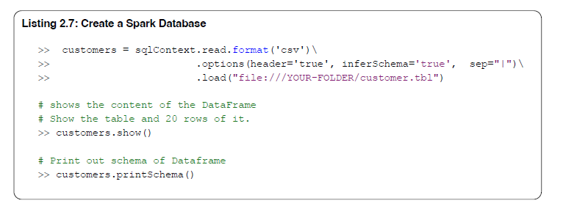
Listing 2.7 is an example of loading data from a CSV (Comma Separated Volume) file.
We can define different signs as the separator sign, if the data set has a different separator sign than comma, like in this example.
Again, Spark detects automatically the data schema and column names can be imported from the header line of the CSV file, if such header line exists in the data file.
In Listing 2.7 two further operations are also used, the first one is the show() operation that you can use to print out a Projection of a dataframe to see what are the column names and data schema. If you need only to look at the schema of your dataframe you can use printSchema() operation.

Slide 26
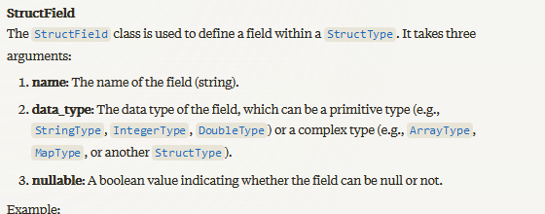

Slide 27
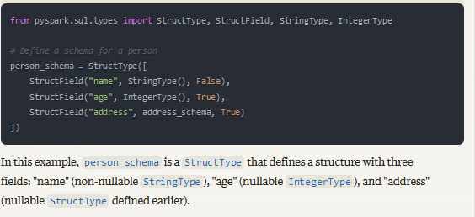
These classes are useful when you need to work with complex data structures in PySpark DataFrames. By defining the schema explicitly, you can ensure that the data is loaded and processed correctly, and you can access the nested fields using dot notation (df.select("address.street")) or by applying transformations and operations on specific fields within the structure.

Slide 28
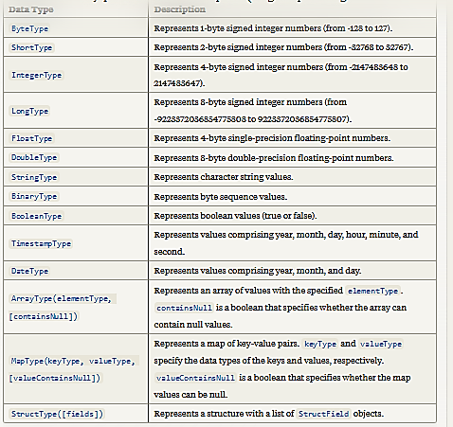
DataTypes

Slide 29
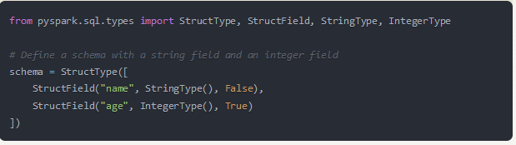

Slide 30
Working with Spark Dataframes
Spark Dataframe provides a list of transformation and action operations similar to spark RDDs operations.
These operations are similar to RDDs with some differences because a dataframe includes data schema and Spark process it in a rational form and database table style.
In the following sections, we describe the most relevant operations and refer the readers to the main documentation page Spark dataframe

Slide 31
DataFrame Operations - Scenario
You are working with a massive dataset containing customer information, purchase history, and product details for an e-commerce company.
The dataset is distributed across multiple machines in a Spark cluster.
Your tasks include performing various data analysis and data wrangling operations on this large-scale dataset.

Slide 32
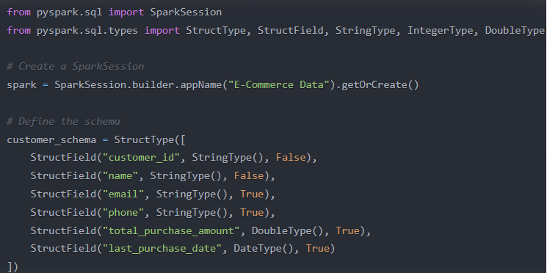

Slide 33
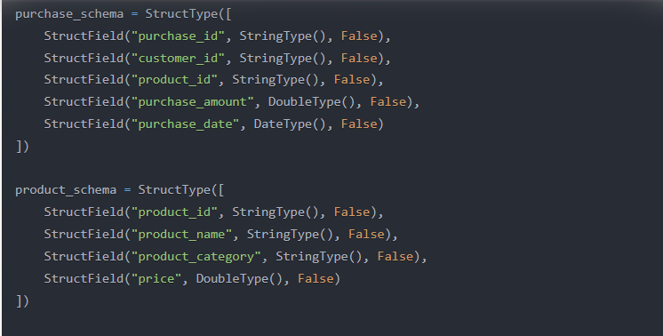

Slide 34
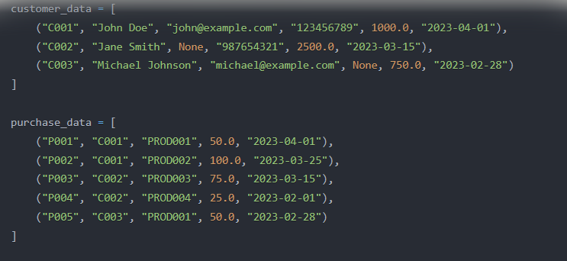
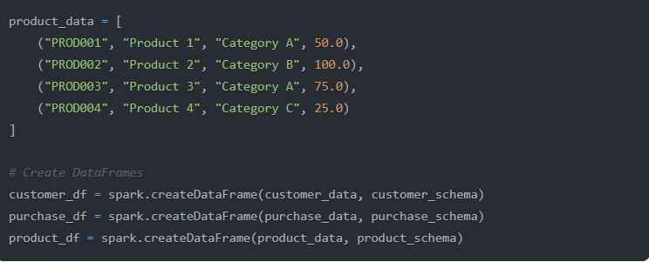

Slide 35
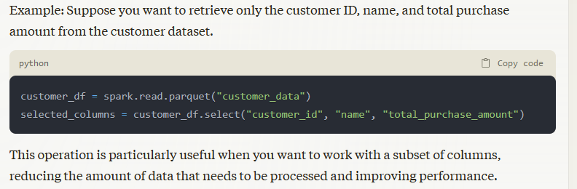
1. Selection
Selection When you need to retrieve specific columns from the dataset, you can use the select operation.

Slide 36
2. Selection with Expression
Selection with Expression If you need to apply expressions or perform computations on the columns, you can use the selectExpr operation.
avg_purchase = customer_df.selectExpr("customer_id", "name", "total_purchase_amount / count(purchase_id) as avg_purchase")

Slide 37
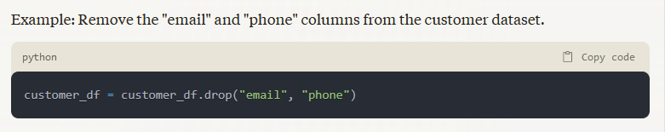
3. Drop
When you want to remove specific columns from the dataset, you can use the drop operation.

Slide 38
4. Filtering Rows
To filter the dataset based on specific conditions, you can use the filter operation.
from pyspark.sql.functions import datediff, current_date
recent_customers = customer_df.filter(datediff(current_date(), "last_purchase_date") <= 180)

Slide 39
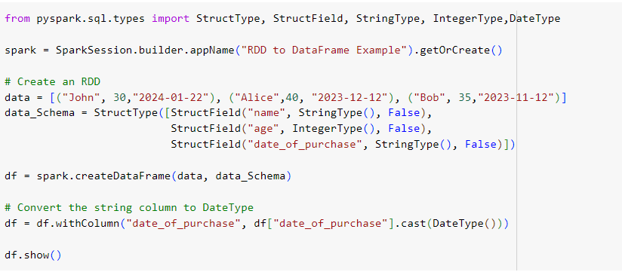
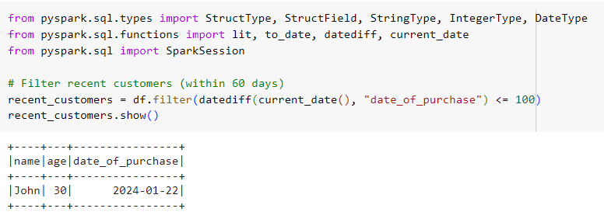

Slide 40
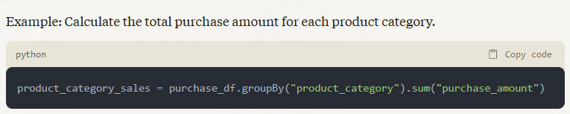
5. Grouping
When you need to group the data based on one or more columns and perform aggregations, you can use the groupBy operation.

Slide 41

6. Join
Join To combine data from multiple datasets, you can use various join operations, such as inner, outer, left, right, and others.
customer_purchase = customer_df.join(purchase_df, customer_df.customer_id == purchase_df.customer_id, "inner")

Slide 42
Outer Join: An outer join returns all rows from both DataFrames, combining rows with matching keys, and filling in the non-matching rows with null values. There are two types of outer joins: full outer join and left/right outer join.
Full Outer Join: Returns all rows from both DataFrames, combining rows with matching keys, and filling in the non-matching rows with null values.

Slide 43
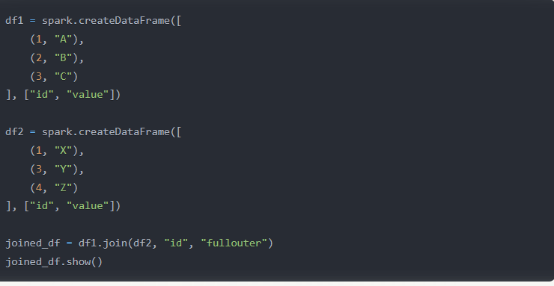
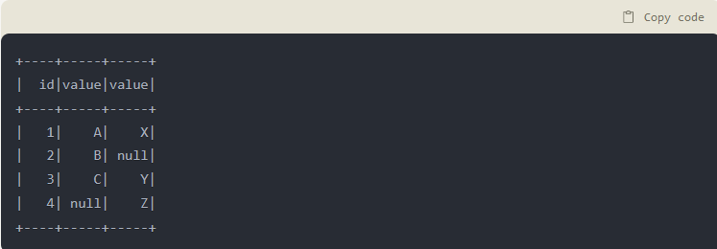

Slide 44
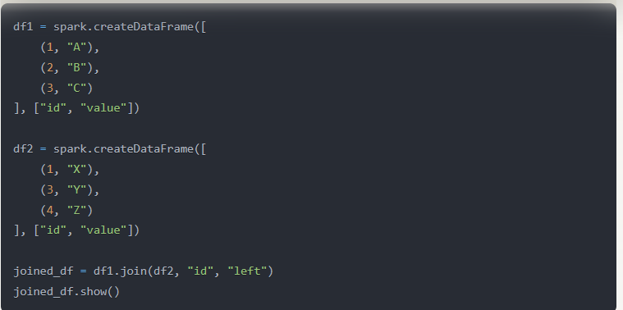
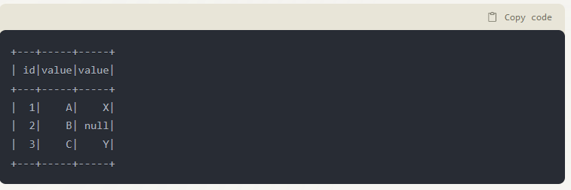
Left Join: A left join returns all rows from the left DataFrame and only the matching rows from the right DataFrame. Non-matching rows from the right DataFrame are filled with null values.

Slide 45
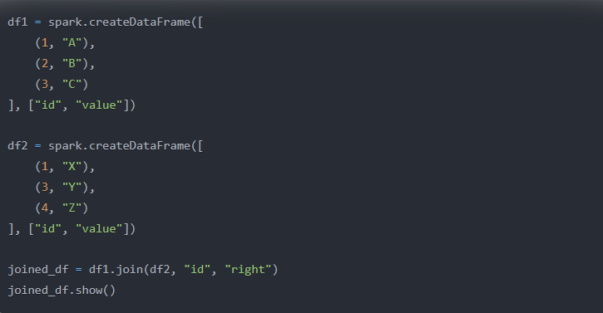
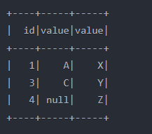
Right Join: A right join returns all rows from the right DataFrame and only the matching rows from the left DataFrame. Non-matching rows from the left DataFrame are filled with null values.

Slide 46
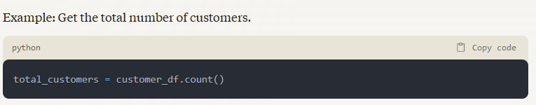
7. Count
Count To get the number of rows in a dataset, you can use the count operation.

Slide 47
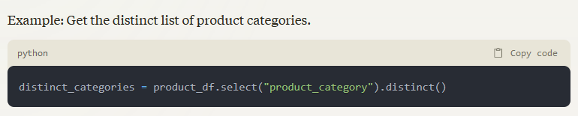
8. Distinct
Distinct If you want to retrieve distinct values from a column or a set of columns, you can use the distinct operation.

Slide 48
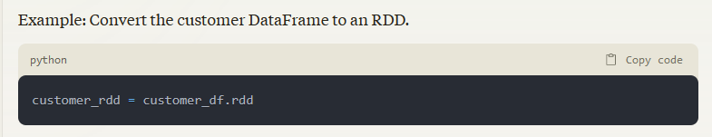
9. Convert Spark DataFrame to RDD
Sometimes, you may need to convert a DataFrame to an RDD for specific operations or compatibility with older Spark code.

Slide 49
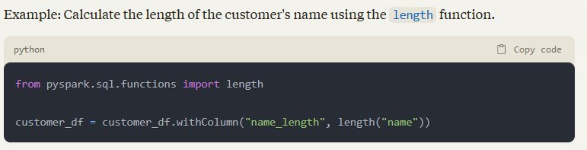
10. Using built-in function
Using Built-in Functions Spark provides a rich set of built-in functions that you can use for various data manipulation and transformation tasks.

Slide 50
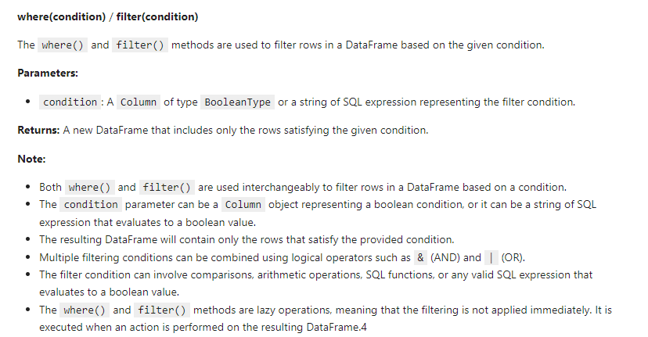
11. where

Slide 51
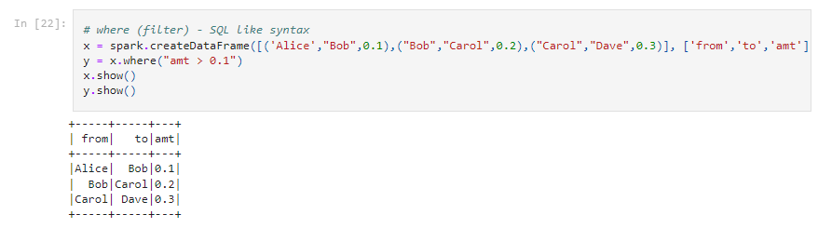

Slide 52
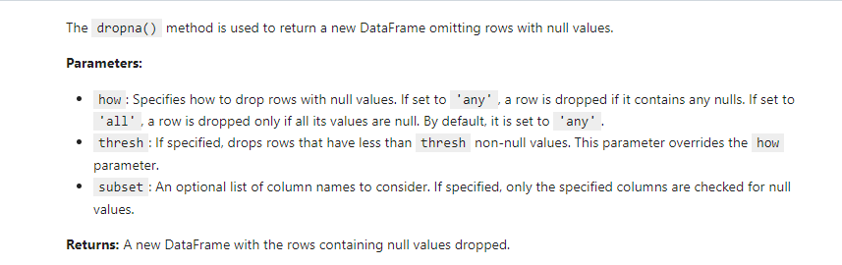
dropna

Slide 53
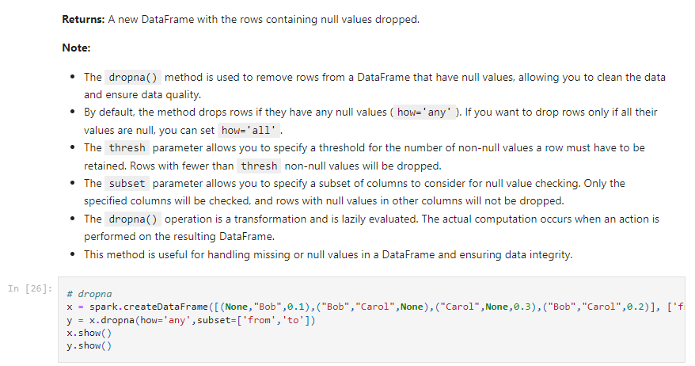

Slide 54
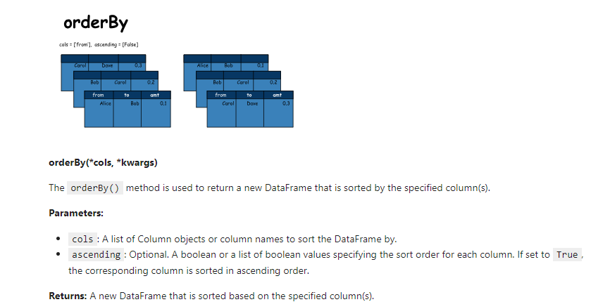
Top K queries

Slide 55
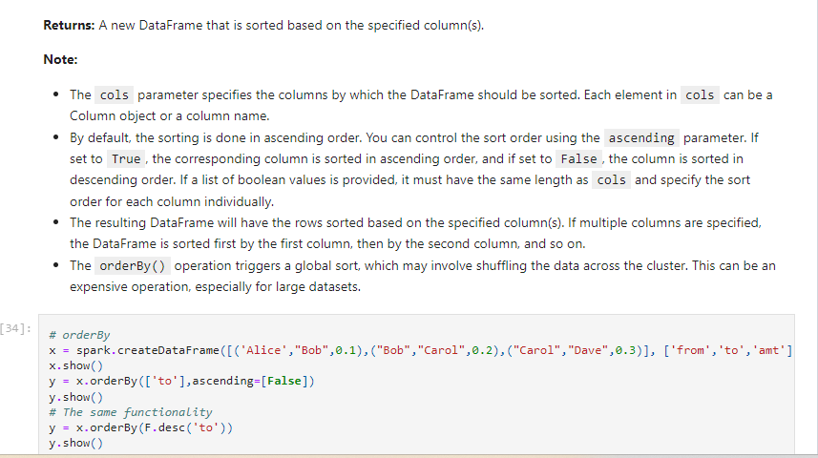

Slide 56
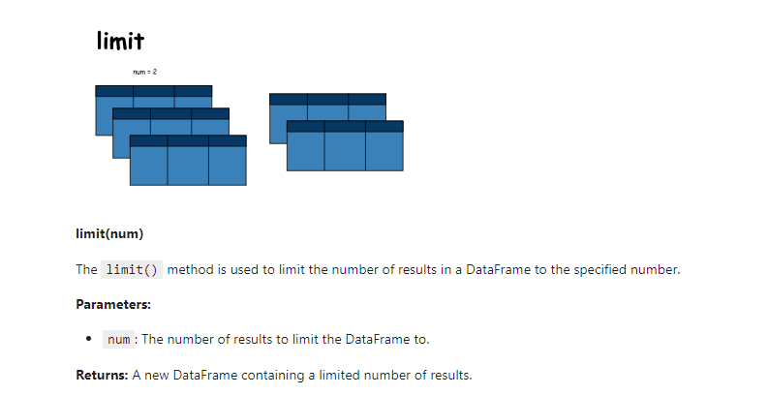
limit

Slide 57
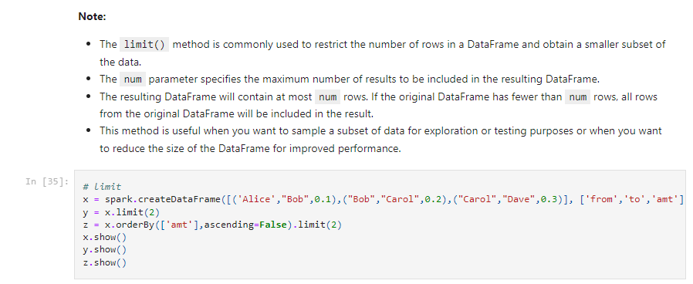

Slide 58
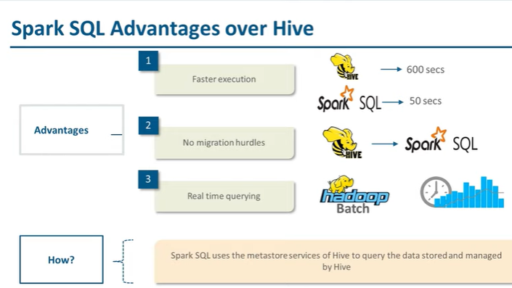
SQL Commands

Slide 59
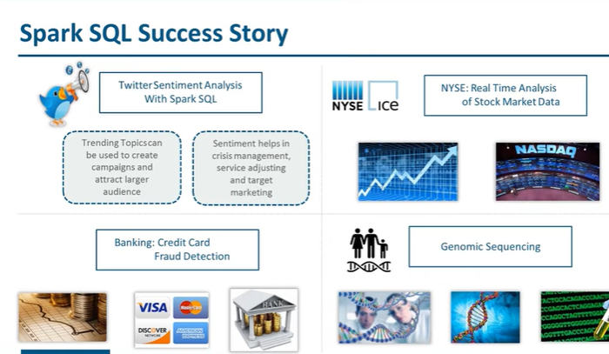

Slide 60
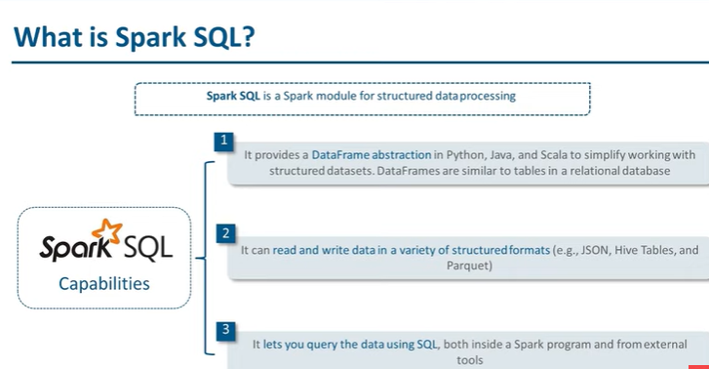

Slide 61
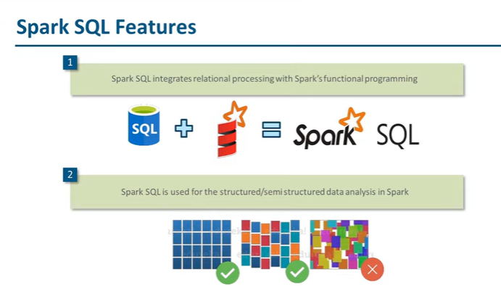

Slide 62


Slide 63


Slide 64
SQL like Operations on DataFrames
sql(sqlQuery)
The sql() method is used to execute a SQL query on a DataFrame and return a new DataFrame representing the result of the query.
Parameters:
sqlQuery: A string containing the SQL query to be executed.
Returns: A new DataFrame representing the result of the SQL query.

Slide 65
Note:
The sql() method allows you to perform SQL queries on a DataFrame, leveraging SQL syntax and capabilities for data manipulation and analysis.
The resulting DataFrame represents the result of the SQL query, with the schema and data determined by the query.
The SQL query can include various operations such as selecting columns, filtering rows, aggregating data, joining tables, and more.
This method is particularly useful when you have complex data manipulation or analysis requirements that can be expressed more easily and concisely using SQL syntax.
The sql() method internally uses the Spark SQL engine to execute the SQL query on the DataFrame.
It's important to ensure that the DataFrame you are executing the SQL query on has been registered as a temporary table or view using the createOrReplaceTempView() method. Otherwise, the SQL query will not be able to reference the DataFrame.
The SQL query can reference column names and perform operations on the columns of the DataFrame. The columns are resolved based on the schema of the DataFrame.

Slide 66
createOrReplaceTempView(name)
The createOrReplaceTempView() method is used to register the DataFrame as a temporary table with the given name. This temporary table can be used to perform SQL queries and operations.
Parameters:
name: A string representing the name to assign to the temporary table

Slide 67


Slide 68


Slide 69


Slide 70


Slide 71


Slide 72


Slide 73


Slide 74
2.2 PySpark + NumPy + SciPy
PySpark is often used for large-scale data processing, and while it's not designed for array computations, it can be integrated with libraries like NumPy and SciPy for numerical and scientific computations on a smaller scale.
This can be particularly useful for tasks like feature engineering, where you might want to apply a NumPy function to each row of a DataFrame.
Here’s a simple example of how you might use these libraries together:
PySpark for data processing: You can use PySpark to handle large datasets, perform SQL operations, and prepare your data.
NumPy for numerical operations: Once you've aggregated or collected data to a smaller size that's manageable in-memory, you can use NumPy to perform numerical operations on that data.
SciPy for scientific computations: Similarly, you can use SciPy for more complex calculations, such as optimization, statistics, and signal processing once the data is in a manageable form.

Slide 75
Numpy:
numpy to create arrays and matrices and perform some operations on them.
NumPy (Numerical Python) is an open source Python library that’s used in almost every field of science and engineering.
It’s the universal standard for working with numerical data in Python, and it’s at the core of the scientific Python and PyData ecosystems.
The NumPy API is used extensively in Pandas, SciPy, Matplotlib, scikit-learn, scikit-image and most other data science and scientific Python packages.
We will also see how to use numpy with spark.

Slide 76

NumPy and SciPy are powerful libraries for mathematics, science and engineering computing including data analysis.

Slide 77


Slide 78


Slide 79

Numpy array creation

Slide 80
Basic array Operations
Addition
Subtraction
Dot product
Sum of all elements
Min element
Multiply, Add and divide each element by a fixed number

Slide 81


Slide 82


Slide 83

Working with mathematical formulas

Slide 84

Spark and NumPY

Slide 85

Key and numpy array in RDD

Slide 86


Slide 87

More complex calculations

Slide 88
Scipy
SciPy is a collection of mathematical algorithms and convenience functions built on NumPy .
It adds significant power to Python by providing the user with high-level commands and classes for manipulating and visualizing data.
Important subpackages:
linalg: Linear algebra
sparse: Sparse matrices and associated routines
stats: Statistical distributions and functions

Slide 89


Slide 90


Slide 91
Why Linear Algebra?
Dimensionality Reduction: Many datasets in big data analytics have a large number of features or dimensions, which can lead to computational inefficiencies and the "curse of dimensionality." Linear algebra techniques, such as Principal Component Analysis (PCA) and Singular Value Decomposition (SVD), provided by SciPy's scipy.linalg module, are commonly used for dimensionality reduction. These techniques help transform high-dimensional data into a lower-dimensional space while retaining most of the relevant information, making it easier to work with and analyze.
Matrix Operations and Linear Systems: Big data analytics often involves working with large matrices and solving systems of linear equations. For example, in machine learning and optimization problems, we need to perform operations like matrix multiplication, inversion, and solving linear systems. SciPy's linear algebra functions, such as scipy.linalg.solve, scipy.linalg.inv, and scipy.linalg.lstsq, provide efficient and numerically stable implementations for these operations, which are crucial when dealing with large-scale data.
Eigenvalue and Eigenvector Computations: Many data analysis techniques, such as spectral clustering, Principal Component Analysis (PCA), and Linear Discriminant Analysis (LDA), rely on computing eigenvalues and eigenvectors of matrices. SciPy's scipy.linalg.eig function efficiently computes these quantities, which are essential for understanding the underlying structure and patterns in large datasets.

Slide 92
Least-Squares Problems: In big data analytics, we often encounter situations where we need to fit a model to data by minimizing the sum of squared errors. SciPy's scipy.linalg.lstsq function provides an efficient and robust implementation for solving linear least-squares problems, which are fundamental in various data analysis tasks, such as regression and curve fitting.
Numerical Stability and Efficiency: When working with large datasets, numerical stability and computational efficiency become crucial. SciPy's linear algebra functions are designed to be numerically stable and optimized for performance, making them well-suited for handling large-scale computations and ill-conditioned matrices that may arise in big data analytics.
Integration with Other Libraries: SciPy's linear algebra functions are compatible and seamlessly integrate with other popular Python libraries for data analysis and machine learning, such as NumPy, Pandas, and scikit-learn. This integration allows for a smooth workflow and enables users to leverage the power of linear algebra operations in conjunction with other data analysis and machine learning techniques.

Slide 93

a (array_like): The square matrix to be inverted. It must be a 2D array or matrix with the same number of rows and columns.
overwrite_a (bool, optional): If True, the input matrix a is overwritten with the inverse matrix. This can save memory but will modify the original input matrix. The default is False.
check_finite (bool, optional): If True (the default), the input matrix a is checked for infinity and NaN values before computing the inverse.

Slide 94


Slide 95


Slide 96
Here's a breakdown of the arguments:
a (array_like): The square coefficient matrix of the system of linear equations.
b (array_like): The right-hand side vector or matrix of the system of linear equations.
overwrite_a (bool, optional): If True, the input matrix a is overwritten with the matrix data required for the computation. This can save memory but will modify the original input matrix a. The default is False.
overwrite_b (bool, optional): If True, the input vector or matrix b is overwritten with the solution vector or matrix. This can save memory but will modify the original input b. The default is False.
debug (None or bool, optional): If debug is True, then the value of the matrix a after each decomposition step is printed out.
check_finite (bool, optional): If True (the default), the input matrices a and b are checked for infinity and NaN values before computing the solution.
assume_a (str, optional): A string describing the properties of the coefficient matrix a. It can be one of 'gen' (general), 'sym' (symmetric), 'her' (hermitian), 'pos' (positive definite), or 'pos_semidef' (positive semi-definite). The default is 'gen'.
transposed (bool, optional): If True, the conjugate transpose of the coefficient matrix a is used. The default is False.
The function returns the solution vector or matrix x to the system of linear equations a @ x = b.

Slide 97
Sparse Matrix
A sparse matrix is a matrix that contains a large number of zero entries.
In many scientific and engineering applications, such as finite element analysis, signal processing, and machine learning, the matrices involved are often sparse.
Storing and manipulating these matrices using traditional dense matrix formats can be inefficient and memory-intensive.
Sparse matrix data structures store only the non-zero entries, along with their indices, resulting in significant memory savings and computational efficiency.

Slide 98
bsr_matrix: Block Sparse Row matrix
coo_matrix: Coordinate format (COOrdinate)
csc_matrix: Compressed Sparse Column format
csr_matrix: Compressed Sparse Row format
dia_matrix: Diagonal format
dok_matrix: Dictionary Of Keys format
lil_matrix: Row-based linked list format

Slide 99
Sparse matrices (scipy.sparse)
SciPy 2-D sparse array package for numeric data
Sparse matrix classes
bsr_matrix(arg1[, shape, dtype, copy, blocksize]) Block Sparse Row matrix.
coo_matrix(arg1[, shape, dtype, copy]) A sparse matrix in COOrdinate format.
csc_matrix(arg1[, shape, dtype, copy]) Compressed Sparse Column matrix.
csr_matrix(arg1[, shape, dtype, copy]) Compressed Sparse Row matrix.
dia_matrix(arg1[, shape, dtype, copy]) Sparse matrix with DIAgonal storage.
dok_matrix(arg1[, shape, dtype, copy]) Dictionary Of Keys based sparse matrix.
lil_matrix(arg1[, shape, dtype, copy]) Row-based linked list sparse matrix.
spmatrix([maxprint]) This class provides a base class for all sparse matrices.

Slide 100


Slide 101


Slide 102


Slide 103


Slide 104
Statistics (scipy.stats)
A large number of probability distributions as well as a growing library of statistical functions
Distributions like: norm, bernoulli, poisson
Statistical functions like:
stats: Return mean, variance
PDF: Probability Density Function
PPF: Percent Point Function (Inverse of CDF)

Slide 105
Let's walk through a scenario where you might want to use scipy.stats on the Iris dataset within a PySpark context. One common task might be to fit a normal distribution to each feature of the Iris dataset for each species, and then calculate some statistics from this distribution.
First, you will need to load the Iris dataset into a PySpark DataFrame, convert it to an RDD, and then use scipy.stats to fit the normal distribution.

Slide 106


Slide 107
2.3 Code Optimization
Data processing of an enormous volume of data requires cluster management and a well-functioning computational implementation code optimized to use all the processing power of the cluster machine and use all available CPU cores and available RAM memory for high-performance processing.
Multi-threading and multiprocessing is the key concept for using all cluster computing resources for data processing.
We want to run multiple processes on different machines and let each of these separate processes run multiple threads in parallel on multiple CPU cores.
In this way, it is possible to use CPU hyper-threading on virtual cores of each machine and have them work together to perform a very large data processing computation in one data processing pipeline.
To achieve scalability by scaling up on each machine and scaling out on multiple machines we use bulk operation and vectorization techniques to achieve multithreading on each running process.

Slide 108
2.6.1. Bulk Operations and Vectorization Techniques
In machine learning data processing, we mostly pre-process and clean up the data first and then create a very large feature matrix.
In PySpark, when we want to use PySpark RDDs to store the large matrix, we prefer to combine Numpy with Spark RDDs and store as values in each row of RDD a single Numpy vector. We store each row of the feature matrix in an RDD row as a single Numpy array.
We can use a unique array of representations like using Spark Sparse or Dense arrays from Spark Mllib library.
Spark Dense arrays representation can be helpful to reduce the required cluster memory because mostly we are working with feature matrix with many zero values.

Slide 109
Listing 2.24 is an evaluation experiment to compare performance differences between using python for-loops and Numpy library.
When we run this script on an example computer, the usage of Numpy was over 200 times faster than using python for-loops.
In Big Data processing this will happen a lot on each process running on different server machines. If each of these tasks can be 200 times faster when using Numpy library this will sum up to an enormous performance difference.

Slide 110


Slide 111


provides another example of how vectorized bulk computation can be done by combining Spark RDDs and Python Numpy.

Slide 112
Dataframes + DenseVector
In Spark dataframes, we need to have data schema for every column. Spark includes a linear algebra library
pyspark.ml.linalg that provides basic data structures and mathematic functions. Linear algebra library
(Linalg) includes Vector.dense and Vector.sparse data structures which work similar to Numpy library in PySpark.
Listing 2.26 is illustrating an example on how these sparse vectors can be included in dataframe

Slide 113


Slide 114


Represent iris dataset as DenseVector

Slide 115
Cluster Configuration
Spark system includes many configuration parameters for setting up the resources for executors and the driver process.
Changing the configurations will change the processing time that your task need to finish a specific task on a Spark cluster.
One of the best practices is to start up large executors and driver that include maximum memory and CPU to each of these processes so they do not terminate on out of memory exceptions easily.
Running lots of small executors will hit the overall performance of the systems because of the costs of related to instantiations, termination and
coordination of small collaborating processes.
https://spark.apache.org/docs/latest/configuration.html

Slide 116
Master URL: The URL of the Spark cluster master node, which can be a standalone master (spark://host:port), a Mesos master (mesos://host:port), a YARN cluster (yarn), or a local machine (local or local[n] for n cores).
Executor Memory: The amount of memory to allocate for each executor process on the worker nodes. This can be set using the --executor-memory or spark.executor.memory configuration.
Driver Memory: The amount of memory to allocate for the driver process, which runs the main Spark application. This can be set using the --driver-memory or spark.driver.memory configuration.
Number of Executors: The number of executor processes to start on the worker nodes. This can be set using the --num-executors or spark.executor.instances configuration.
Executor Cores: The number of cores to allocate for each executor process. This can be set using the --executor-cores or spark.executor.cores configuration.

Slide 117
Dynamic Allocation: Spark can dynamically adjust the number of executors based on the workload. This can be enabled using the --conf spark.dynamicAllocation.enabled=true configuration.
Shuffle Partitions: The number of partitions to use for shuffle operations, which can affect the performance of certain operations like reduceByKey and join. This can be set using the --conf spark.sql.shuffle.partitions=n configuration.
Serialization: Spark can use different serialization libraries like Kryo or Java serialization. The serialization library can be configured using --conf spark.serializer=org.apache.spark.serializer.KryoSerializer.
Event Log: Spark can write event logs for monitoring and debugging purposes. This can be enabled using --conf spark.eventLog.enabled=true and specifying a directory for the logs using --conf spark.eventLog.dir=/path/to/logs.
Environment Variables: Environment variables can be set for the Spark processes using the --conf spark.executorEnv.VAR_NAME=value and --conf spark.driverEnv.VAR_NAME=value configurations.

Slide 118


Slide 119
Basic Linear Algebra in PySpark
PySpark's MLlib library includes basic linear algebra data types like Vectors and Matrices, which are essential for many algorithms in machine learning and data processing:
Vectors: PySpark supports two types of vectors: dense and sparse. A dense vector is backed by a double array representing its entry values, while a sparse vector is backed by two parallel arrays: indices and values.
Matrices: Similar to vectors, PySpark has dense and sparse matrices. A dense matrix stores all entries in a single array in column-major order, while a sparse matrix stores only the nonzero values and their indices.

Slide 120


Slide 121
Linear algebra is a fundamental component of many data processing and machine learning algorithms, and its importance in PySpark arises from several key reasons:
Scalability: PySpark is designed to handle large-scale data processing and analysis. Linear algebra operations, such as matrix multiplication and eigenvalue decomposition, are essential for many machine learning algorithms. By supporting linear algebra, PySpark enables the development and execution of scalable machine learning algorithms that can handle big data.
Efficiency: Linear algebra operations are often computationally intensive. PySpark's distributed computing capabilities allow these operations to be performed efficiently across a cluster of machines, reducing the time required for data processing and analysis.
Data Representation: Many data types, such as images, text, and genomic data, can be represented as vectors or matrices. Linear algebra provides a mathematical framework for manipulating these representations, enabling tasks like image processing, natural language processing, and genomic analysis.
Machine Learning: PySpark's machine learning library, MLlib, relies heavily on linear algebra for various algorithms, including regression, classification, clustering, and dimensionality reduction. Efficient linear algebra operations are crucial for training and deploying these models on large datasets.
Interoperability: PySpark integrates with other libraries and tools that use linear algebra, such as NumPy and SciPy in Python. This interoperability allows developers to leverage existing linear algebra routines and algorithms within their PySpark applications.
Expressiveness: Linear algebra provides a concise and expressive language for describing complex data transformations and relationships. By supporting linear algebra, PySpark enables developers to implement sophisticated data processing and analysis algorithms in a clear and concise manner.

Slide 122
Distributed File Storage
PySpark can create distributed datasets from any storage source supported by Hadoop, including your local file system, HDFS, Cassandra, HBase, Amazon S3, etc.
Spark supports text files, SequenceFiles, and any other Hadoop InputFormat.
Once created, distFile can be acted on by dataset operations.

Slide 123
In PySpark, distributed file storage systems are used to store and manage large volumes of data across a cluster of machines. These systems are designed to handle big data processing and analysis efficiently. Here are some key points about distributed file storage in PySpark:
Hadoop Distributed File System (HDFS): HDFS is the most commonly used distributed file storage system with PySpark. It is designed to store large files across multiple machines in a cluster. PySpark can read and write data to HDFS, making it suitable for processing large datasets.
Amazon S3: PySpark can also work with Amazon S3, a scalable object storage service offered by Amazon Web Services (AWS). S3 can be used to store and retrieve any amount of data, at any time, from anywhere on the web. It is often used for data backup, archiving, and big data analytics.
Google Cloud Storage (GCS): Similar to Amazon S3, PySpark can interact with Google Cloud Storage, which is a highly durable and available object storage service offered by Google Cloud.
Azure Blob Storage: Microsoft Azure's Blob Storage is another option for storing large amounts of unstructured data in the cloud. PySpark can access data stored in Azure Blob Storage for big data processing.

Slide 124
Reading and Writing Data: PySpark provides various APIs to read and write data from and to distributed file storage systems. For example, you can use the DataFrameReader and DataFrameWriter classes for reading and writing data in different formats like CSV, JSON, Parquet, Avro, etc.
Partitioning: When dealing with large datasets, partitioning is a crucial aspect. It helps in distributing the data across the cluster, which enhances parallel processing and reduces the overall processing time. PySpark allows you to specify partitioning strategies when reading or writing data.
Fault Tolerance: Distributed file storage systems like HDFS are designed to be fault-tolerant. They replicate data across multiple nodes in the cluster to ensure that the system can recover from a node failure without data loss. PySpark leverages this feature to ensure that big data processing is resilient to failures.

